Slide 1
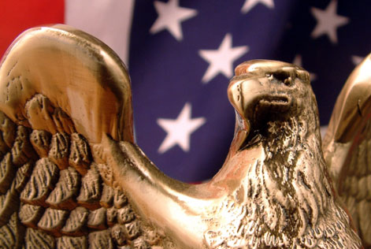
“Our Nation’s First Governments”

Slide 2
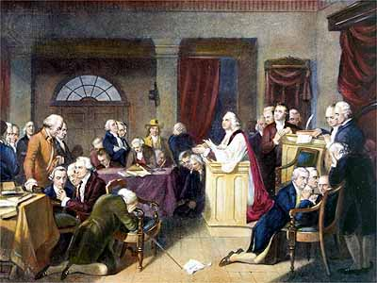
Urge for Self Government
Massachusetts was the first colony to organize as a state AND draft a state “constitution” --which is a detailed, written plan for government.
By 1780, the remaining states also followed their lead.
Most state constitutions included (limitations on gov’t):
  A bill of rights
  Legal protections
  Guarantees basic freedoms

Slide 3
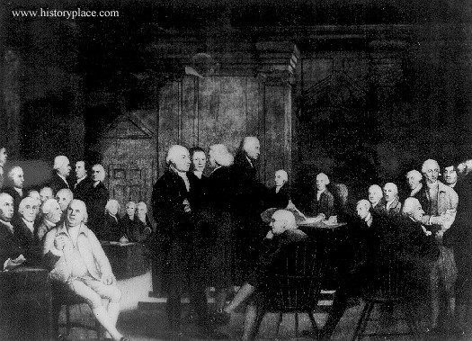
New Governments -Legislatures
These early state governments created legislatures to create laws.
Most legislatures were “bicameral”, meaning they were divided into TWO houses or parts.

Slide 4
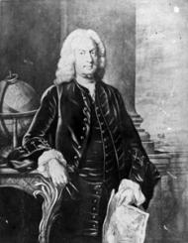
New Governments - Executives
Each state had a governor (executive) who was either elected by the state legislature or by the people.
The governor’s job was to carry out the laws.

Slide 5
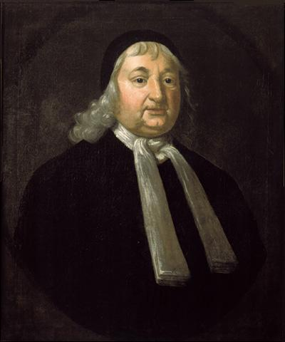
New Governments - Judicial
Finally, a system of judges and courts (judiciary) were created in each state.
The court’s job was to interpret the laws and decide how the laws should be applied.

Slide 6

Massachusetts
Massachusetts would eventually become a great example for our future government---- they Split power among 3 branches (Baron de Montesquieu) – legislative, executive and judicial
Also had a system of checks and balances - Governor could “check” power of legislature.
State constitutions were created by elected delegates, and then were approved by their citizens.

Slide 7

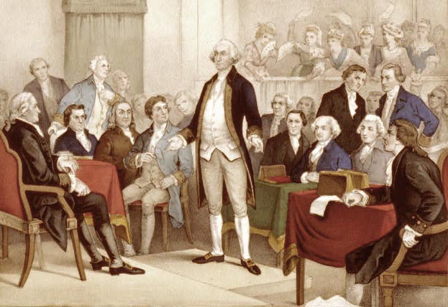
Need for Unity
If the colonies were to be successful against Great Britain, it was imperative that they stand united.
They had to “unite to fight”!!!!
13 separate states would be easily conquered by Britain.

Slide 8
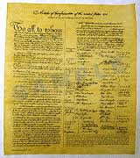
“Articles of Confederation”
In order to unite, the states created the Articles of Confederation.
The “Articles of Confederation” was the first attempt at a constitution for the United States.
A “confederation” is a group who bands together for a common purpose.
  - a league of friendship!
AofC established a system for cooperation among independent states. The states wanted the power to stay with them.

Slide 9
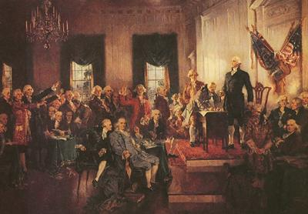
Articles of Confederation
The “Articles of Confederation” created a one house (unicameral) legislature called Congress, with each state having one vote.
  The Main powers of the Articles of Confederation Congress included overseeing the army and dealing with foreign countries. (why?)

Slide 10
Problems Quickly Begin!
By 1781, all 13 states ratified, or approved the Articles.
There were strict voting requirements to amend, meaning change, the Articles of Confederation. Amending required all 13 states’ approval – this made it very difficult to change any part of the Articles.
The government under the AofC was not very strong!

Slide 11
Problems Quickly Begin!
The states liked the A of C at first because - Each state was said to have equal power and were totally independent of one another.
But Problems would arise that were too big to ignore.

Slide 12

The Gov’t seemed like THIS…

Slide 13

But it was really like THIS!!

Slide 14
Problems Quickly Begin!
  During the Revolution, the Articles of Confederation Congress was effective because it helped us UNITE to FIGHT – we won the American Revolution…………but after the Revolution, the problems were obvious… WRITE this…………
  Weaknesses
  - No central leadership (executive)
  No power to regulate commerce (trade)
  No power to enforce it’s laws
  No national court system to carry out justice
  No power to tax the people. (Left deep in debt)
  Any changes required UNANIMOUS consent of all 13 states!!

Slide 15
The Government looked good, but had no real power!

Slide 16
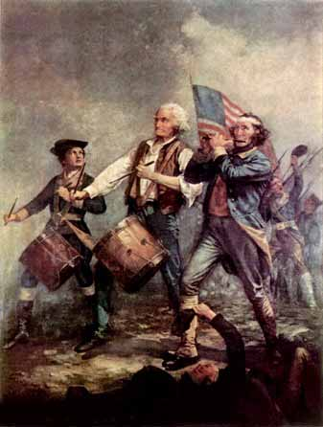
Revolutionary War
In 1783, the “United States” defeated Great Britain after 7 years of war. The Articles of Confederation was successful in accomplishing its goal!
The “Treaty of Paris” ended the conflict.
The new Congress found itself deep in debt (as did the states). Why – what weakness of the Articles contributed to this problem???

Slide 17
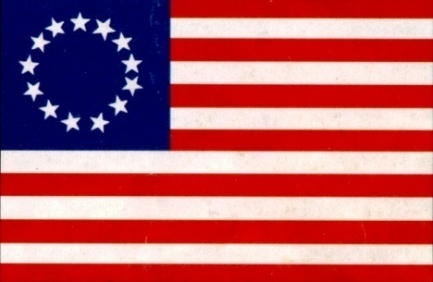
Failure of the
“Articles of Confederation”

Slide 18
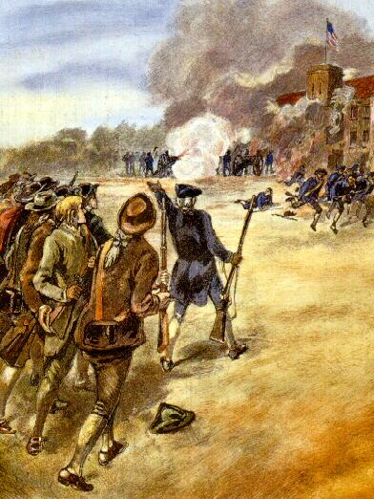
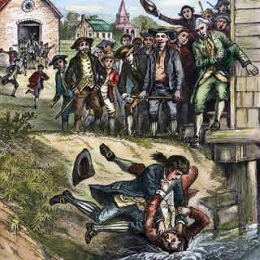
Shay’s Rebellion (1786-1787)

Slide 19
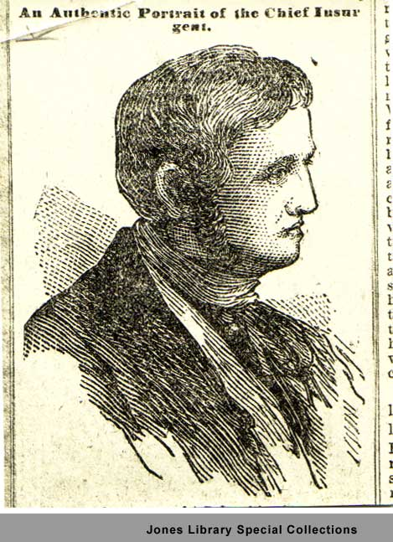
Shays’ Rebellion (1786-1787)
In Massachusetts, a farmer named Daniel Shays-- led over 1,200 farmers on a raid against a federal arsenal. This was called “Shays’ Rebellion”.
Shays was upset because of the government’s inability to tax and their large debt meant that the soldiers were not getting paid for their service in the Army and thus were losing their farms/homes.
Shays was protesting the seizure of his farm by the government. The gov’t stopped the rebellion, but realized there was a BIG problem!

Slide 20
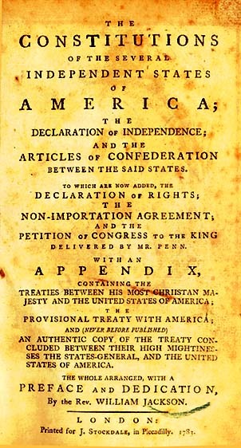
Failure of the
“Articles of Confederation”
By 1787, most realized that the “Articles of Confederation” would not provide the type of government Americans wanted
The Aof C Created a “confederal” government system that was weak!!! ----- the delegates wanted to create a “federal” system with a strong central government where power was shared between the national government and the states.

Slide 21
Confederal vs. Federal vs. Unitary
Under the A of C we had a “confederal” system of government where ALL the power belonged to the states…there was no strong central power.
Under the US Constitution we have a “federal” system of government where power is shared between the national government and the states.
A unitary system of government is where ALL power belongs to a strong national government - (i.e., France, North Korea, etc.)

Slide 22
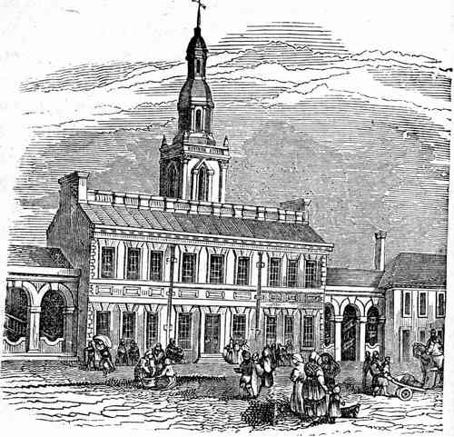
Return to Philadelphia
After Shays Rebellion, 12 of the 13 states (all but Rhode Island) agreed to return to Philadelphia to revise/fix the “Articles of Confederation”. Right away, it became obvious at the meeting to fix the Articles of Confederation that they (the AoC) were not fixable. They were just too WEAK!
Instead, the delegates at the convention decided that they needed to start completely over and write a new constitution all together. This meeting would turn into the Constitutional Convention where the delegates would write a whole new plan of government called the U.S. Constitution.
The goal of the delegates was to create a
stronger central government – a Federal System to
replace the Confederal one under the Articles.

Slide 23
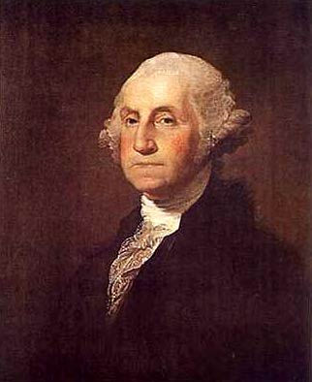
George Washington’s Advice
“I do not conceive we can exist long as a nation without having lodged somewhere a power which will pervade the whole Union.”
What does this mean?

